Slide 1

Fake and Real News Detection
using NLP and LSTM Deep Learning

Slide 2

Introduction
Fake News is pervasive nowadays and is too easy to spread with social media and it is difficult for us to identify. Since the Covid-19 outbreak in Taiwan recently, a lot of fake news has popped up on social networks, such as LINE, Facebook, PTT (one of the largest online forums in Taiwan), etc. Hence, we aim to utilize multiple artificial intelligence algorithms to detect fake news to help people recognize it.

Slide 3

Currently, we are in a world of mis-information and fake news. The goal is to detect fake news based on Recurrent Neural Networks.
Natural language processors (NLP) work by converting words (text) into numbers. These numbers are then used to train an Al/ML models to make predictions.
Al/ML-based fake news detector is crucial for companies and media to automatically predict whether circulating news is fake or not.

Slide 4

PROBLEM STATEMENT
Analyze and predict wheather news is fake or real.

Slide 5
Methodology
Understanding Problem Statement
Data Acquisition , Preparation
Exploratory Data Analysis(EDA)
Data Modeling
Data Visualization , Result

Slide 6
Flow Chart
Data Collection
Text Processing
Calculate Polarity Of Sentiment Words
Calculate Total Score Of Text
Result

Slide 7
Step 1:- Understanding The Problem Statement
Analyze a subjective response of a Fake and Real news.
What Is Fake News?
* Stories that aren't true.
* Stories that have some truth, but aren't 100 percent accurate.
Step 2:- Data Acquisition, Preparation .
Data Acquisition/ Data Collection:-
To analyze the Fake and Real news , we need to collect data from Radio , Newspaper and Magazines. Press Interviews., Press Conferences. , Police Stations., Social Media.
Preparation :-
The data we get from Sources is not a dataset that is ready to be used for any kind of data analysis task.
So, to prepare our data for the sentiment analysis task, we need to define all the required functions.

Slide 8
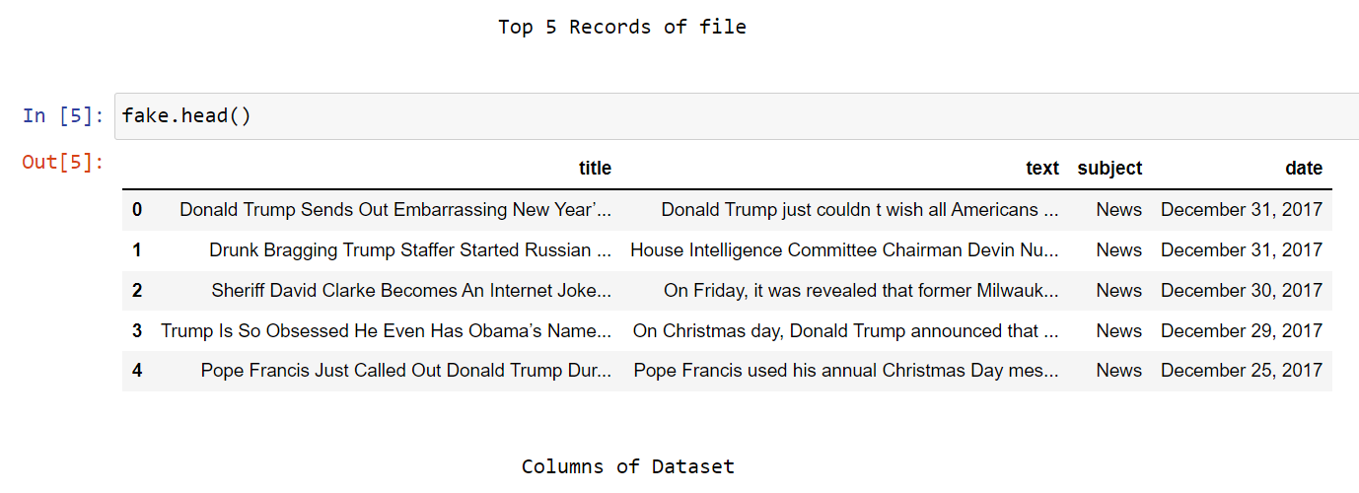
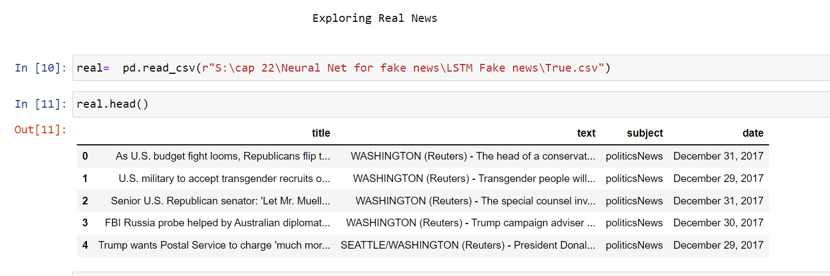
Fig.:- Data Collection
Fake News
Real News

Slide 9
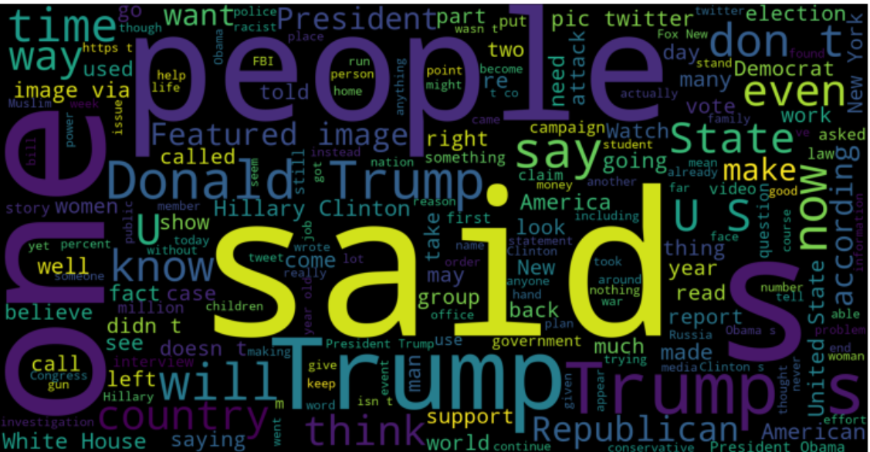
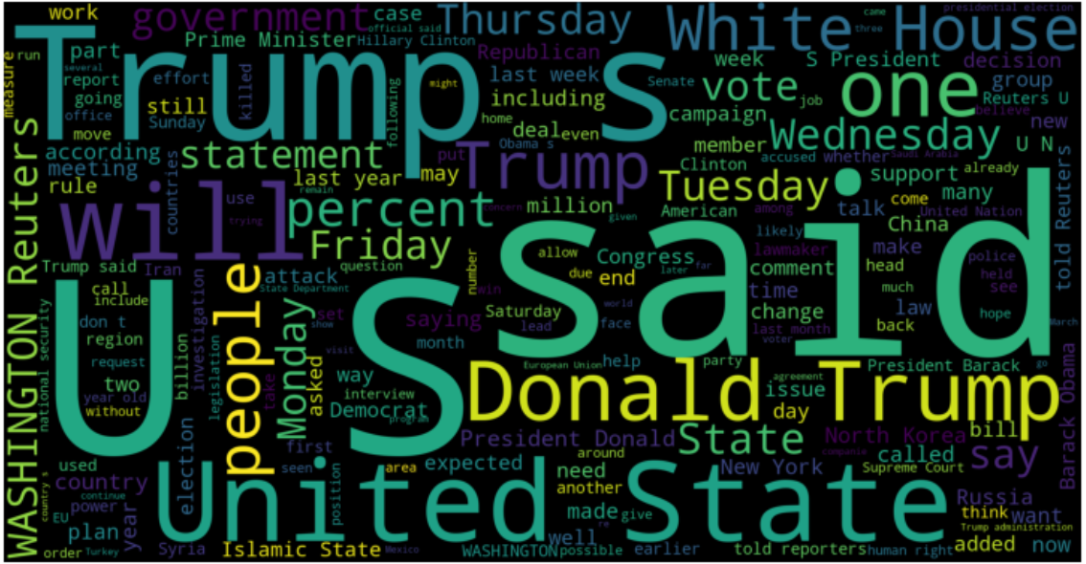
Step 3:- Exploratory Data Analysis(EDA) :- EDA is all about making sense of data in hand, before getting them dirty with it. It is a graphical analysis of data. As we have text data we use Word Cloud graphical analysis to know the frequency of text.
Fake News
Fig.:- WordCloud
Real News

Slide 10
Step 4:- Data Modeling
Data modeling/NLP involves following features:-
Word Boundaries
Tokenization
Stemming
TF-IDF
Stopword
Disambiguation
Topic Model
Speech Tagging

Slide 11
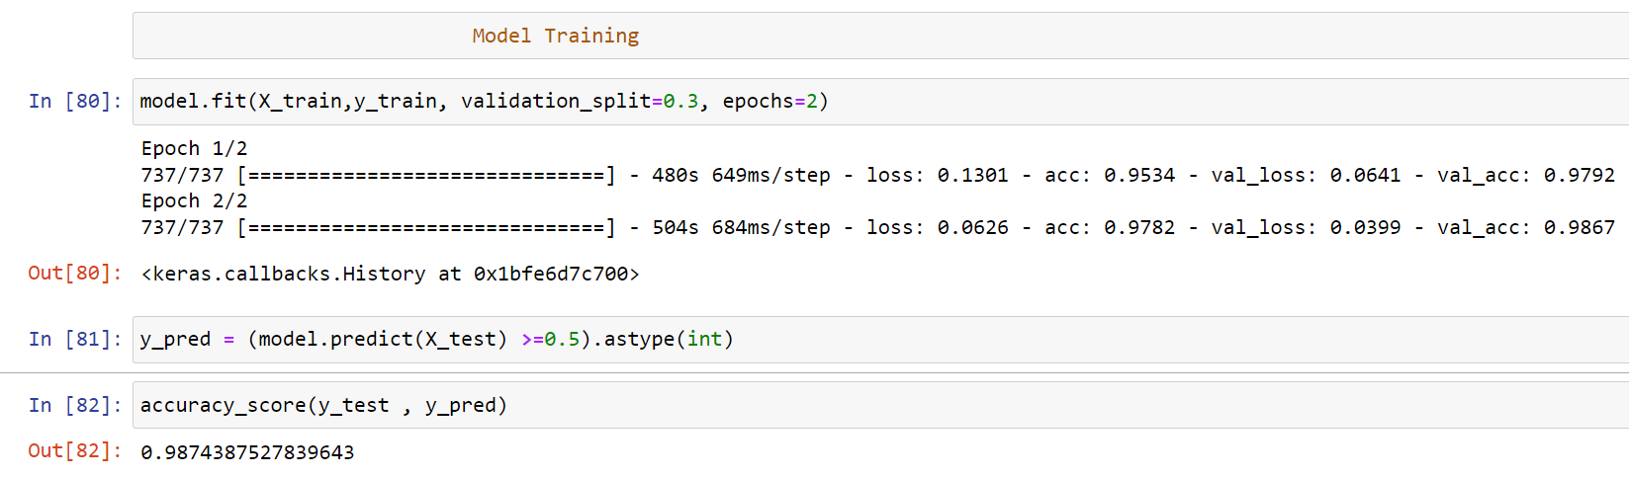
Step 5:-Model Training and Result

Slide 12
Real – World Implement
To implement this in real life , we can make Mobile app or what’s up integrated feature .
Conclusions
In recent years, fake news detection plays an important role in national security and politics. In this paper, we covered the implementation of deep learning models (LSTM) and NLP that have been proposed for fake news detection on the Fake News dataset. We applied the Fake and Real datasets with preprocessing and word embedding to get word sequences, and then input these sequences into our models.
We found that the experimental results of our models are giving best result and Accuracy close to 98.74%.

Slide 13
Thank you
- Pankaj Kande [PGA - 23]

Slide 14
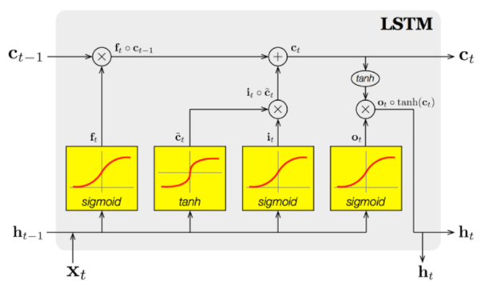
### LONG SHORT- TERM MEMORY (LSTM) LSTM is a recurrent neural network (RNN) architecture that REMEMBERS values over arbitrary intervals. LSTM is well-suited to classify, process and predict time series given time lags of unknown duration. Relative insensitivity to gap length gives an advantage to LSTM over alternative RNNs, hidden Markov models and other sequence learning methods.

Slide 15
# Importing Libraries and Datasets
# TASK #3: PERFORM EXPLORATORY DATA ANALYSIS
# TASK #4: PERFORM DATA CLEANING
VISUALIZE CLEANED UP DATASET
PREPARE THE DATA BY PERFORMING TOKENIZATION AND PADDING
# TASK #7: UNDERSTAND THE THEORY AND INTUITION BEHIND RECURRENT NEURAL NETWORKS AND LSTM
# TASK #8: UNDERSTAND THE INTUITION BEHIND LONG SHORT TERM MEMORY (LSTM) NETWORKS
# TASK #9: BUILD AND TRAIN THE MODEL

